Slide 1

In Our Community
Downingtown, Caln & Surrounding Areas

Slide 2
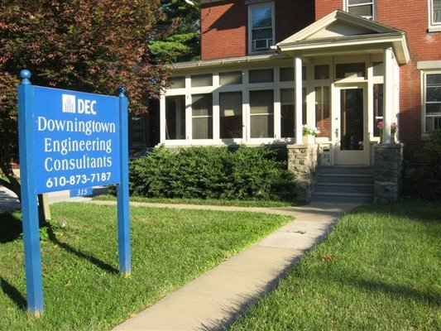
Downingtown Engineering Consultants, Inc.
Small Structural Engineering Company
Designed Planet Fitness in Downingtown, PA
Licensed in 11 states
Advised us:
Electrical work
Support for our bar
Connections to other companies
eg. EMS Systems

Slide 3

Skills/Training for STEM
STEM jobs need people who are trained in specialized areas.
For example, engineers can specialize in:
Architectural
Chemical
Mechanical
Nuclear
Specialized jobs still require a background in other areas in order to be successful.
Specialized workers can work together with one another on complicated projects requiring many skill sets.
Many professions have common aspects with others.
All require a basic understanding of Science, Technology, Engineering, and Math.

Slide 4
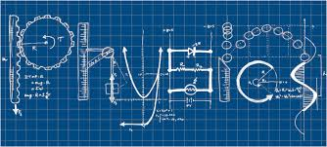
Skills/Training for STEM (cont.)
Although there are many STEM majors focusing on different things, these majors usually require similar classes.
All engineers usually take these courses for their first two years:
Calculus
Inorganic and Organic Chemistry
Calculus-Based Physics
Foreign Language
Basic Engineering Class
The second two years of education become more focused on the individual majors.
Professional Engineers need to take evaluating tests as well as gain experience under a professional before being certified.

Slide 5
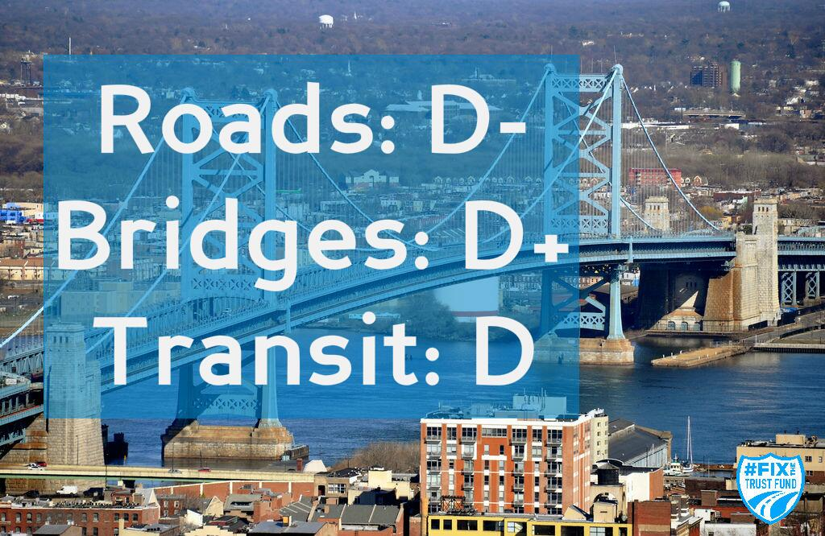

Challenges in the Community
A changing world - constant development
PA’s infrastructure is poorly rated, ineffective and overly expensive in many fields
Drinking water, bridges, transportation, energy, ports, waste management, school facilities, etc. - All rated mediocre or worse (pareportcard.org) in Pennsylvania - cost the state billions - Damage citizen’s quality of life
Improvement in these areas requires dedication to and utilization of STEM skills and critical thinking

Slide 6
Influence of the Project
Connection to Caln Township
Same principle - Signs not easily seen when flipped open
Primarily found within Caln Township in Chester County; used statewide & across other states nationwide
Signs in action
Rarely opened, practically useless - Future improvements for automatic opening sign to meet the demand
Research - Crash statistics - PA infrastructure - Increasingly poor ratings - 44% of roads rated poor by DOT - Roads received D- grade - Lack of improvement and increased deterioration increase accident probability and expenditures (pareportcard.org)

Slide 7
Team Reflections
Strengths
Andrew - Science/Tech Research/Application and Group Organization
Angela - Engineering and Business Partnership/Research
Conor - Engineering Principles -Calculations/Implementation
Matt - Leadership and Real World Application
Steve - Presentation Style and Problem Solving/Design

